Slide 1
Research Methods
Research Strategies / Methods

Slide 2
Survey defined -
A Survey is:
a collection of information in standardised form from samples of known populations to create quantifiable data with regard to a number of variables from which correlations and possible causations can be established.

Slide 3
Focus
Survey research focuses on naturally occurring phenomena. Rather than manipulating phenomena, survey research attempts to influence the attitudes and behaviors it measures as little as possible. Most often, respondents are asked for information.

Slide 4
Types of Data
Survey research is primarily quantitative, but qualitative methods can be used.

Slide 5
Sampling
A researcher may be able to gather data from all members of a population. Most of the time, the population is so large that researchers must sample only a part of the population and make conclusions about the population based on the sample.
Because of this, a good sampling scheme is often critical in survey research.

Slide 6
Survey Research Classifications
Classified according to PURPOSE
Exploratory survey: to form general ideas about the research questions
Descriptive survey: to collect more specific descriptions of the variables of interest
Explanatory survey: to develop understanding of relationships among variables of interest

Slide 7
Classification
Classified according to TIME
Cross-sectional survey: Data are collected at one point in time from a sample selected to represent a larger population.
Longitudinal surveys: to collect data over time.
Trend Studies: Surveys of sample population at different points in time
Cohort Studies: Study of same population each time data are collected, although samples studied may be different
Panel Studies: Collection of data at various time points with the same sample of respondents.

Slide 8
Classification
Classified according to DATA COLLECTION APPROACHES
Face-to-Face Survey
Mail Survey
Telephone Survey
Web Survey

Slide 9
Survey Research Process
The survey research process includes:
the design of a survey
the acquisition of a sample
the fielding of the survey
the analysis of the collected data
the presentation of results

Slide 10
Issues to consider in survey research
What is your RESEARCH QUESTION?
Population: accessibility, literacy, and language issues?
Sampling: available data and participation of respondents?
Questions: type, length, and complexity? existing questionnaire?
Content: knowledge of?
Bias: honest responses and social desirability?
Administrative: cost, time, and equipment?

Slide 11
Experiment
A research investigation in which conditions are controlled
One independent variable is manipulated (sometimes more than one)
Its effect on a dependent variable is measured
To test a hypothesis

Slide 12
Basic Issues of Experimental Design
Manipulation of the Independent Variable
Selection of Dependent Variable
Assignment of Subjects (or other Test Units)
Control Over Extraneous Variables

Slide 13
The experimental design
1.
Control
group
Pre-test
Post-test
5.
Experimental
group
Pre-test
Post-test
2.
3.
4.
Notes:
45

Slide 14
TEST UNITS - subjects or entities whose response to the experimental treatment are measured or observed.

Slide 15
Laboratory Experiment
Field Experiment
Artificial-Low Realism
Natural-High Realism
Few Extraneous
Variables
Many Extraneous
Variables
High control
Low control
Low Cost
High Cost
Short Duration
Long Duration
Subjects Aware of
Participation
Subjects Unaware of
Participation

Slide 16
Ethnography
-Derived from the Greek, the term ethnography means a description of people in relation to their culture.
-Ethnography is concerned with understanding human behaviour in the cultural and social context in which takes place.
-The researcher seeks to understand the cultural perspectives of the group using participant observation, interviewing and field notes.

Slide 17
Ethnography
It is used in studying history, religion, politics, economy and environment.
Observations and interviews are the main data collection tools.
-Ethnographer can not only ask questions, but also observe. They use all senses in data collection: vision, hearing, smell, touch, taste.

Slide 18
Limitations of ethnographic studies
The possibility that the researcher may immerse herself in the particular culture she studies to the extent that she is unable to have an objective view of the situation even after fieldwork has been completed.
-It is not possible for the ethnographer to be in all places at he same time.

Slide 19
Action research
First used by K.Lewin in 1946
May involve practitioners who are also researchers e.g.
professionals in training.
Research may be part of the organisation ,e g school,
University, hospital, and the researcher is actively
involved in the promotion of change within it.
Issue of transference of knowledge from one context
to another.

Slide 20
Types of Action Research Designs
Action Research
Practical
Participatory
Studying local practices involving individual or team based inquiry
Focusing on participant development and learning
Implementing a plan of action
Leading to the participant-as researcher
Studying social issues that constrain individual lives
Emphasizing equal collaboration
Focusing on “life enhancing” changes”
Resulting in the emancipated researcher

Slide 21
Mill’s (2000) Action Research Spiral
Identify an
Area of Focus
Develop an
Action Plan
Collect Data
Analyze and
Interpret Data

Slide 22
Case Study Research
Case studies looks intensely at an individual or small participant pool, drawing conclusions only about that participant or group and only in that specific context.
Case studies typically examine the interplay of all variables in order to provide as complete an understanding of an event or situation as possible.
Unlike more statistically-based studies which search for quantifiable data, the goal of a case study is to offer new variables and questions for further research.

Slide 23
Case Study Research
A case study approach is often used to build up a rich picture of an entity, using different kinds of data collection and gathering the views, perceptions, experiences and ideas of diverse individuals relating to the case.
Case studies provide what is termed ‘rich data’.

Slide 24
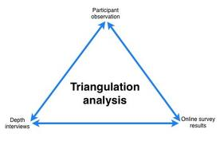
Trangulation
Using more than 2 data forms of collection.
Provides fuller and more robust picture of the case.

Slide 25
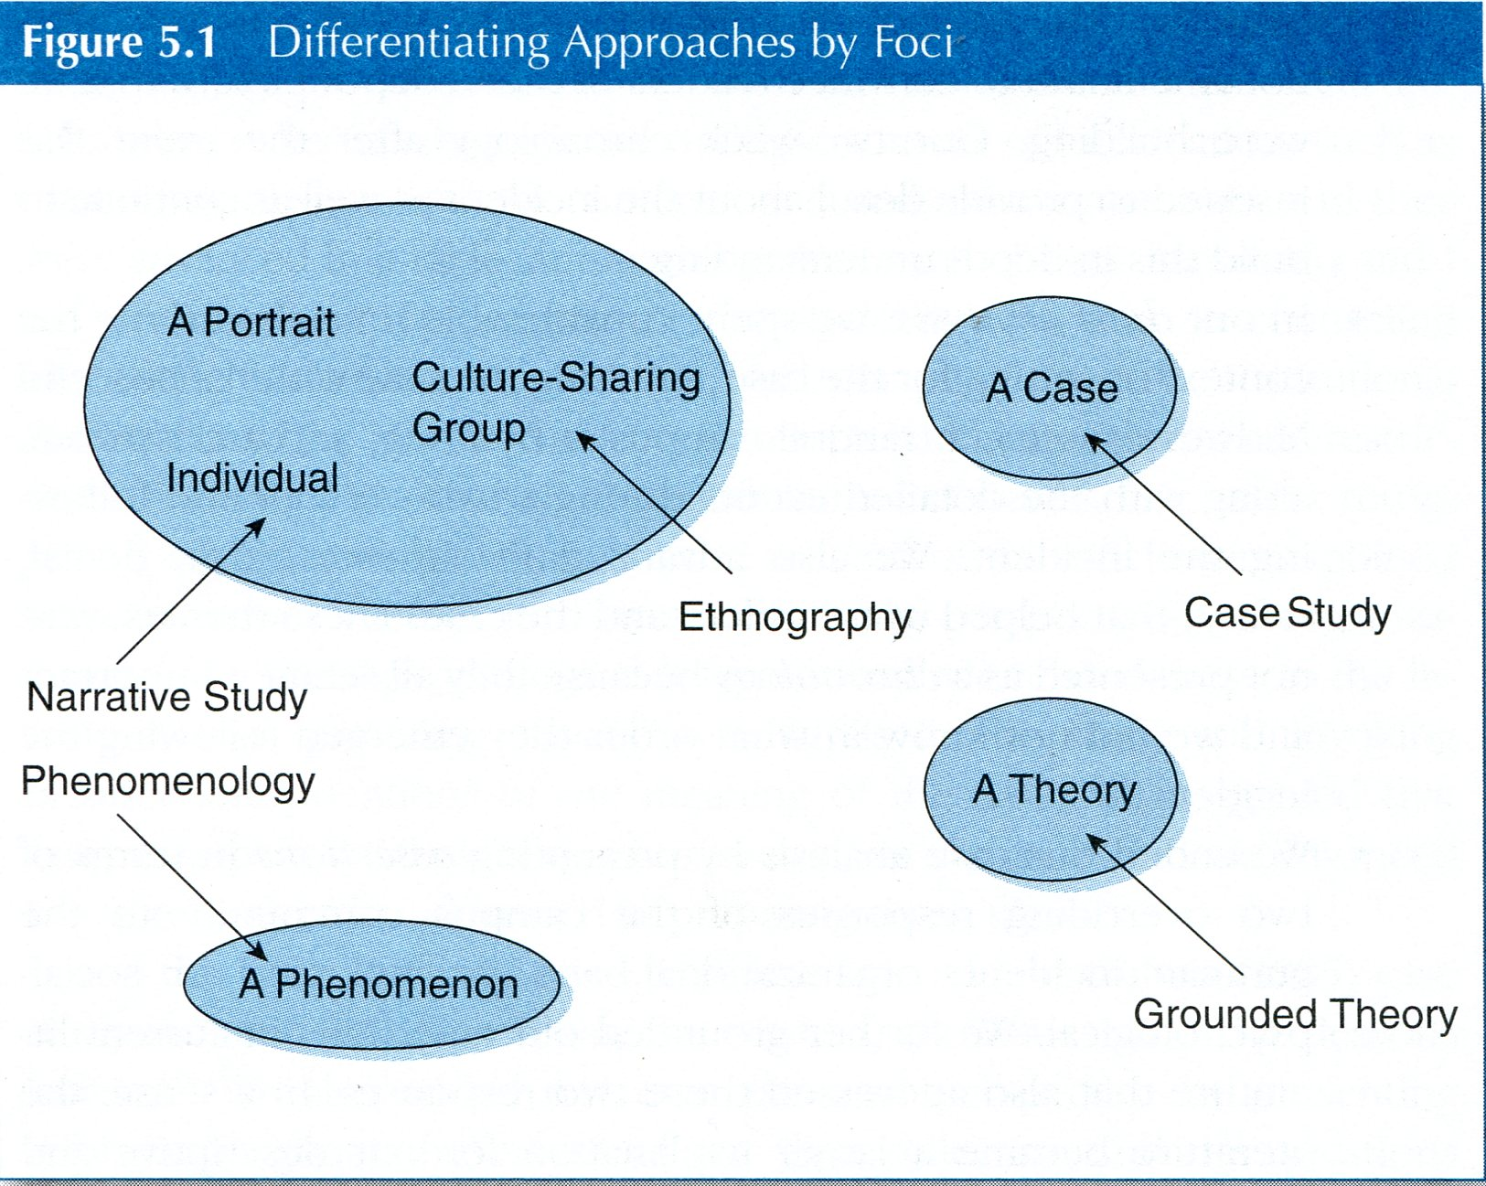
Case Study Research
In comparison to other types of qualitative research studies, case studies separate out a particular sample of the larger population to investigate.

Slide 26
Case Study Research
Researcher Robert K. Yin defines the case study research method:
....an empirical inquiry that investigates a contemporary phenomenon within its real-life context; when the boundaries between phenomenon and context are not clearly evident; and in which multiple sources of evidence are used (Yin, 2009).

Slide 27
Types of Case Studies
Illustrative Case Studies These are primarily descriptive studies. They typically utilize one or two instances of an event to show what a situation is like.
Exploratory (or pilot) Case Studies These are condensed case studies performed before implementing a large scale investigation.
Cumulative Case Studies These serve to aggregate information from several sites collected at different times.
Critical Instance Case Studies These examine one or more sites. This method is useful for answering cause and effect questions.

Slide 28
Design Science Research
Research Paradigm in which a designer answers questions relevant to human problems via the creation of innovative artifacts, thereby contributing new knowledge to the body of scientific literature. The designed artifact/s are both useful and fundamental in understanding that problem.
Principle: Knowledge and understanding of a design problem and its solution are acquired in the building and application of an artifact.
Hevner & Chatterjee (2010)

Slide 29
Artefact
Problem
Person
People, Practices & Problems
Johannesson
& Perjons (2012)
uses
addresses
perceives
Notes:
Artefacts as Solutions to Problems in Practice
Johannesson & Perjons (2012)
Artefacts do not exist in isolation but are embedded in context

Slide 30

DSRP Model Peffers et al (2006)
Problem Identification
Motivation
Objectives of a Solution
Respond to Requirements
Design & Development
Artifact
Demonstration
Proof of Concept
Evaluation
Collect Feedback
Communication
Publish output
Notes:
Problem centred approach
Inference – what would a better artifact accomplish?
Theory – course design and development – must aim at changing the real world
‘How to’ knowledge – use artifact to solve problem (pilot course)
Metrics analysis knowledge – Observe how effective
Disciplinary Knowledge – publish as OER & reflexive research

Slide 31
Action Design Research
qualitative research method that combines theory and practice by focusing interest on two goals
solving the immediate problem in a situation and contributing to social science through reflection on the effect of actions undertaken in solving the immediate problem (Avison, Lau, Myer and Nielsen, 1999; Cole, Purao, Rossi and Sein, 2005; Sein et al, 2011)

Slide 32
Problem Formulation
Principle 1: Practice-Inspired Research
Consider field problems (real-world problems)
Action design research method is applied to study intersection of technological and organizational domains.
The researcher can investigate how technological solutions can be used to improve organizational processes and achieve better results.

Slide 33
Problem Formulation
Theory-Ingrained Artifact
emphasizes that created artifacts are based on theories.
The applied theories can be universal laws of natural science or ADR-researcher can utilize the specific theory (e.g. TAM, IS-succes)

Slide 34
Build – Intervention and Evaluation
building of the IT artifact
intervention in the organization
Evaluation
The outcome of the BIE stage is the realized design of the artifact.
During BIE, the problem and the artifact are continually evaluated, and the design principles are articulated for the chosen class of systems.

Slide 35
Reflection and Learning
The designed artifact will reflect preliminary design and ongoing shaping by organizational use, perspective and participants.

Slide 36
Formalized Learning
Generalization of the problem instance
Generalization of the solution instance
derivation of design principles from the design research outcomes.
Share outcomes and assessment with practitioners
Articulate outcomes as design principles
Articulate learning in light of theories selected

Slide 37
ADR (Sein et al, 2011)

Slide 38
Thank you for listening
Questions?

